Slide 1

Innovations
Task Master III
Delivering Experience, Quality and Service since 1934.
James E. Bowie, Jr., Ph.D., P.E. January, 2011

Slide 2
Innovations
Task Master III
Water King has a truly innovative system of water softeners and filters. They are innovative because of the design, service and manufacturing.

Slide 3
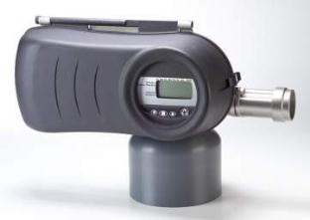
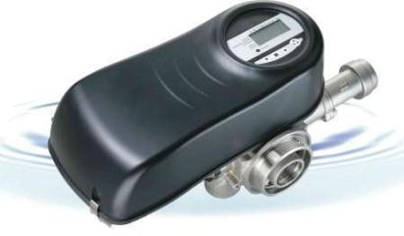
Water King Task Master III (TM III)
Design
Manufacturing
Service

Slide 4
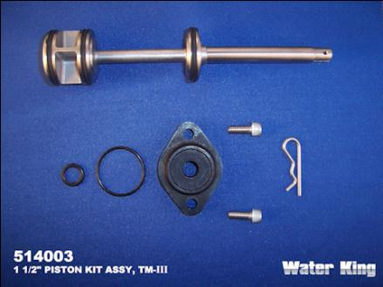
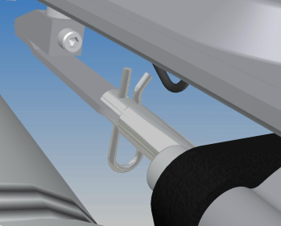
DESIGN – Task Master III
Over molded Dual-Lobe Seals
Mechanical simplicity
One moving part - the piston

Slide 5
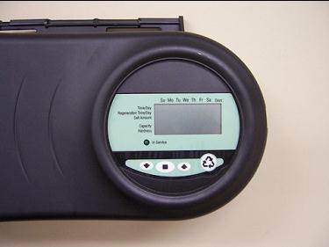
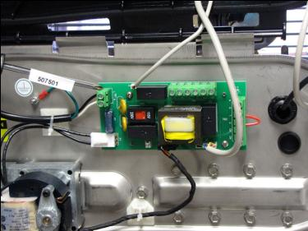
DESIGN – Task Master III
Fully Controlled with Modern Electronics

Slide 6
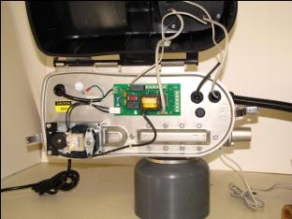
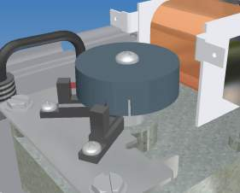
DESIGN – Task Master III
Optical Sensors guide piston into position
Accurate and Repeatable
No micro-switches
No positioning cams
No wear parts
No calibration

Slide 7
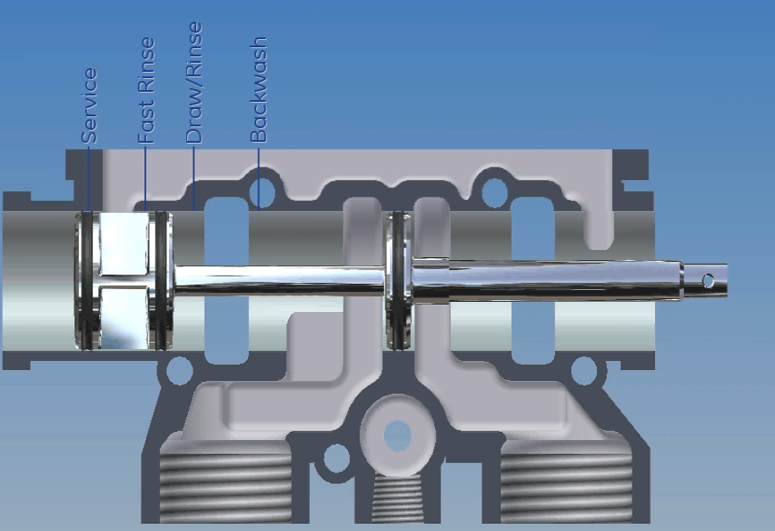
DESIGN – Task Master III
Elegant design

Slide 8
DESIGN – Task Master III
Flow Diagram

Slide 9
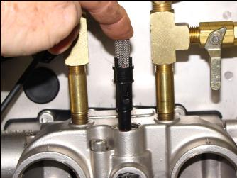
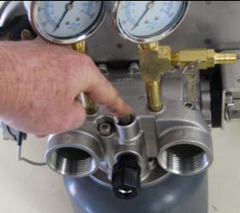
DESIGN – Task Master III
Internal brine injector

Slide 10
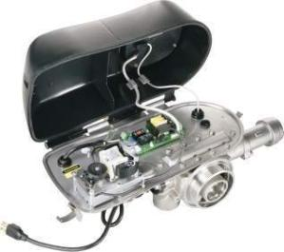
DESIGN – Task Master III
Removable
NEMA 4 / IP65 control enclosure
NEMA 4 flexible plastic conduit for shut off kits
You can squirt it with a water hose

Slide 11
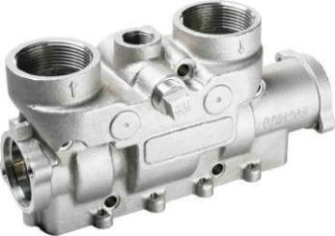
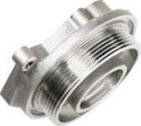
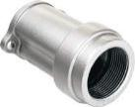
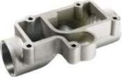

DESIGN – Task Master III
Corrosion Resistant
All metal contact parts are Austenitic Passivated 316 Stainless Steel
High Temperature – 180˚ F

Slide 12
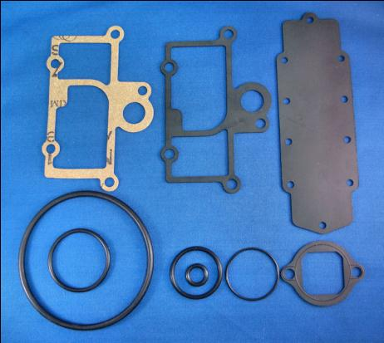
DESIGN – Task Master III
Corrosion Resistant
Gaskets and O-rings are EDPM
Cork Gaskets for tank adaptor for low temperature non corrosive applications

Slide 13
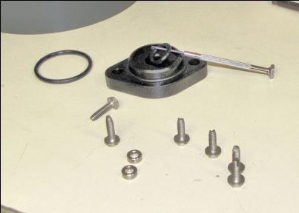
DESIGN – Task Master III
Corrosion Resistant
Plastic end caps are Noryl

Slide 14
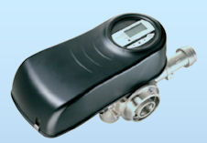
DESIGN – Task Master III
Zero lead.
Stainless steel contains no lead.
No brass fittings in contact with the water.
Both no lead and low lead brass have some lead content.
Tank adaptor is also Austenitic Passivated 316 Stainless Steel

Slide 15
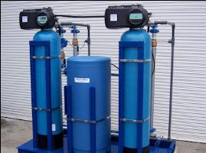
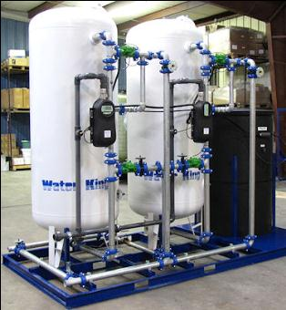
DESIGN – Task Master III
Broad application
Very broad range of systems use exactly the same valve and control system.
RF 50 to MF 1200
12”Ø to 48”Ø

Slide 16
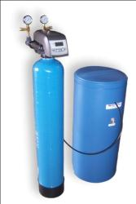
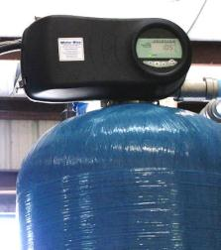
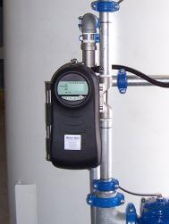

DESIGN – ERC Controller
One controller for all system types
BF SERIES
RF SERIES
MF SERIES
VN SERIES

Slide 17


SERVICE – Task Master III
Simple one piece piston
Over molded Dual-Lobe Seals
Can be efficiently replaced

Slide 18

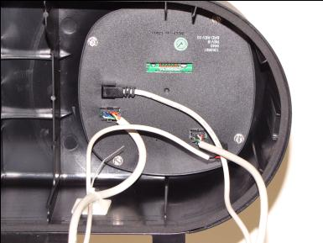
SERVICE – Task Master III
Electronics are Plug and Play

Slide 19
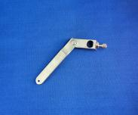

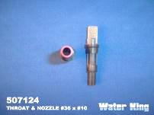
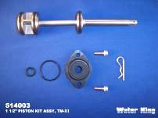
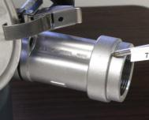
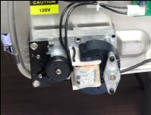
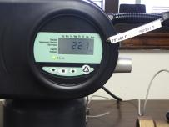
SERVICE – Task Master III
Only seven parts

Slide 20
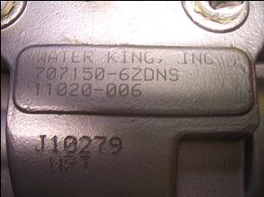
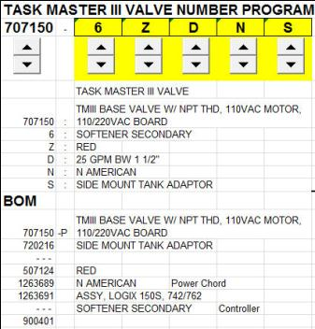
SERVICE – Task Master III
Valves are serialized
Factory will know exact configuration of valve as originally manufactured

Slide 21
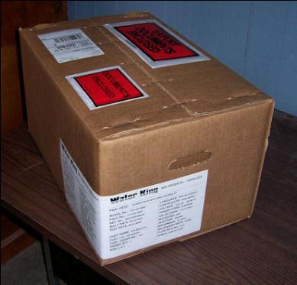
SERVICE – Task Master III
Valve is not heavy or dangerous to work on
Shipping weight is only 25 lbs

Slide 22
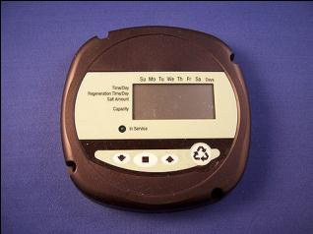

SERVICE – Task Master III
Programming is user friendly and efficient
Push button manual regeneration
Push button step through on cycles

Slide 23
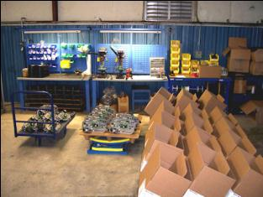
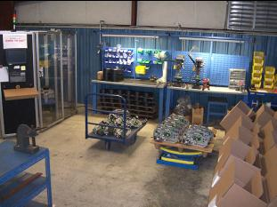
MANUFACTURING – Task Master III
Valves made in our shop with “our own two hands”
Joe, Jason and Hector assemble and test the valves
Ray keeps the test machine functioning
Jim stays out of the way
Notes:
This is another option for an Overview slides using transitions.

Slide 24
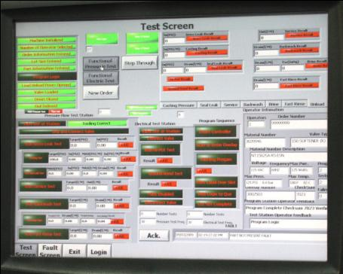
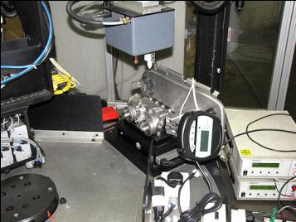
MANUFACTURING – Task Master III
Rigorous quality control on all components
Every valve individually tested
100% testing
Notes:
This is another option for an Overview slides using transitions.

Slide 25
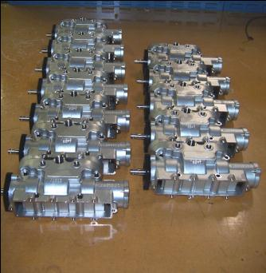
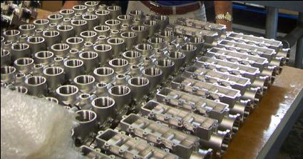
MANUFACTURING – Task Master III
American Machining
Machining quality is critical to this product
Notes:
This is another option for an Overview slides using transitions.

Slide 26
MANUFACTURING – Task Master III
We are the beneficiaries of a multi million dollar development effort by GE Osmonics.
This product was designed to be the best, most modern, most reliable on the market.
Notes:
This is another option for an Overview slides using transitions.

Slide 27
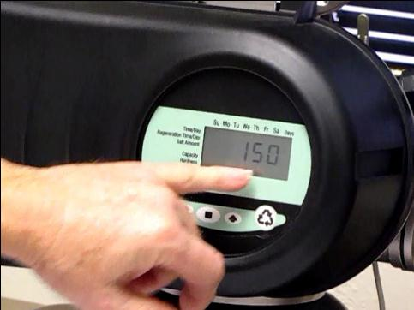
Water King Task Master III (TM III)
Click image to view
TM-III programming demonstration

Slide 28
Water King – Task Master III -Advantage
Best value to the customer
Exclusivity
Continuing Parts and Repair Business
Direct personal contact with manufacturer – We stand behind our product
Expertise
Experience

Slide 29
Questions?

